Slide 1

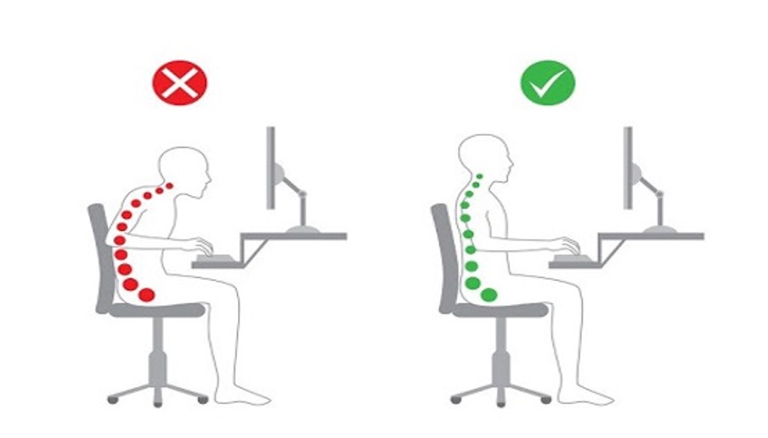
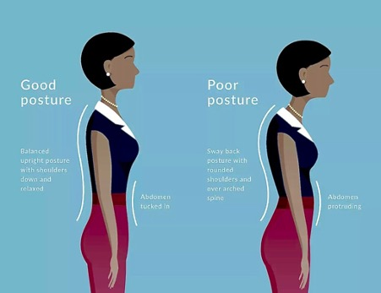
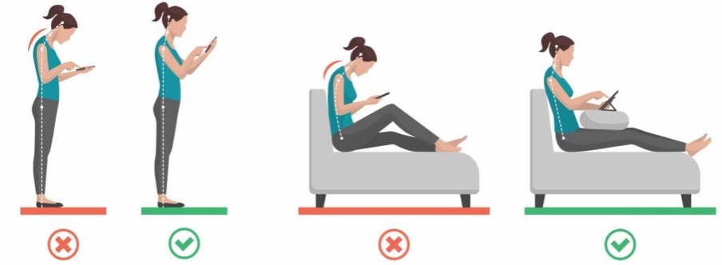


6 Posture Tips to Attain Peak Performance
Don’t Be a Slouch!
Straighten up!!
Pretend you’re standing against a wall to measure your height.
Beware of text neck!
Bring the screen to eye level so your head is not slouched forward or too high.
Sit all the way back in your chair- Place a small, rolled-up towel or lumbar cushion behind your back
Bend your knees at a right angle - keep them the same height. Place your feet flat on the floor.
Hold your head straight and tuck in your chin
Stand with your shoulders back, knees straight, and belly tucked in.
Take time off from your smart devices. Even 5 minutes every hour will do.
Do 20 minutes of neck exercises or modalities like yoga.
When you sit - your earlobes in line with your shoulder
Choose a lower, chunky heel for daily wear or wear a sneakers
Sleep right!
Choose a firm mattress one that helps hold your spine’s natural shape.
Do daily core!
Have a well-designed daily workout plan
Avoid heels!
Side sleeper- Bend your knees slightly but don’t hug them.
Back sleepers- ditch the thick pillow and opt for a small one under the neck.
Include a few core strengthening exercises in your daily regime
https://www.myspineworld.com/

